Slide 1
Hybrid Machine Learning for Bankruptcy Prediction: Polish Case Study
Guide:T.Veerraju M.Tech(Ph.D.)
TEAM MEMBERS:
Nallamilli Lakshmi M Vigneswara Reddy 21MH1A0542
Damalanka Pujitha Jagadeeswari 22MH5A0502
Vudathu Aishwarya 21MH1A0565
Boda Nikhil 22MH5A0501

Slide 2
ABSTRACT:
Bankruptcy prediction is a critical aspect of financial risk management, helping businesses, investors, and financial institutions make informed decisions to mitigate potential losses. This project introduces a robust machine learning-based bankruptcy prediction system that analyzes key financial indicators to determine a company’s financial health. Our approach integrates advanced feature selection and optimization techniques, such as Genetic Algorithms (GA) for identifying the most relevant financial attributes and Particle Swarm Optimization (PSO) for fine-tuning model parameters, ensuring enhanced prediction accuracy. The system utilizes multiple machine learning algorithms, including Logistic Regression, Random Forest, and Decision Trees, to classify companies as "Bankrupt" or "Non-Bankrupt." It processes critical financial metrics, such as cash flow, profit margins, liabilities, assets, and debt-to-equity ratios, to derive meaningful insights. By efficiently handling large datasets, managing missing values, and addressing class imbalances, our model ensures high reliability in predicting financial distress. In addition to classification, the system generates risk scores, visual analytics, and detailed financial reports to assist stakeholders in proactive decision-making. The implementation of this hybrid machine learning framework enhances early warning systems, enabling businesses to anticipate financial difficulties, restructure operations, and prevent potential insolvency. The system is designed with a user-friendly interface, making it accessible to financial analysts, investors, and corporate decision-makers. By leveraging the power of data-driven prediction models, this project contributes to strengthening financial stability, improving investment strategies, and optimizing risk management practices.

Slide 3
SYSTEM/TECHNICAL REQUIREMENTS:
H/W CONFIGURATION:
Processor - I3/Intel Processor
Hard Disk - 160GB
Key Board - Standard Windows Keyboard
Mouse - Two or Three Button Mouse
Monitor - SVGA
RAM - 8GB

Slide 4
S/W CONFIGURATION:
• Operating System : Windows 7/8/10
• Server side Script : HTML, CSS(For Frontend Graphics)
• Programming Language : Python
• Libraries : Flask, Pandas, Mysql.connector, Os, Scikit
-learn, Numpy
• IDE/Workbench : Visual Studio Code
• Technology : Python 3.6+

Slide 5
STATEMENT ABOUT THE PROBLEM
The problem addressed in this study revolves around improving the accuracy of bankruptcy forecasting using hybrid machine learning techniques, specifically on an unbalanced Polish dataset. Bankruptcy prediction is crucial for financial institutions to mitigate risks and make informed decisions. However, traditional methods often struggle with imbalanced datasets where the number of bankrupt companies is significantly smaller than non-bankrupt ones, leading to biased models that favor the majority class. This imbalance challenges the model's ability to generalize and accurately predict bankruptcies. The study aims to leverage hybrid machine learning techniques, combining the strengths of different algorithms such as ensemble methods, deep learning, and feature engineering, to address these challenges. By enhancing the predictive power of models on the unbalanced Polish dataset, the research aims to provide more robust and reliable bankruptcy forecasts, thereby aiding financial institutions in making proactive and effective risk management decisions.

Slide 6
PROPOSED SYSTEM
The proposed bankruptcy prediction system is designed to identify financially distressed companies with higher accuracy by utilizing machine learning algorithms and optimization techniques. In this project, models such as Random Forest (RF) and Logistic Regression (LR) are applied to classify companies as bankrupt or non-bankrupt based on relevant financial attributes. To enhance model performance, feature selection is performed using Genetic Algorithms (GA), helping the system focus on the most influential financial indicators. Furthermore, Particle Swarm Optimization (PSO) is employed to fine-tune the model’s hyperparameters, improving its predictive capabilities. The integration of these methods results in a robust and efficient framework that aids stakeholders such as investors, analysts, and financial institutions in proactively assessing risk and making informed decisions regarding financial stability.

Slide 7
OBJECTIVE OF THE PROJECT
The objective of the project "Advancing Bankruptcy Forecasting with Hybrid Machine Learning Techniques: Insights from an Unbalanced Polish Dataset" is to enhance the accuracy and reliability of bankruptcy prediction models using a combination of advanced machine learning techniques. Focusing on an unbalanced Polish dataset, the project aims to address the challenge of imbalanced data distribution in bankruptcy prediction, where the occurrence of bankruptcies is significantly lower compared to non-bankruptcies. By leveraging hybrid machine learning approaches, such as ensemble learning, deep learning, and feature engineering, the project seeks to develop a robust model capable of effectively identifying potential bankruptcy cases with high precision and recall. Through this research, the goal is to contribute new insights and methodologies that improve the predictive performance of bankruptcy forecasting models, thereby assisting financial institutions and stakeholders in making informed decisions and mitigating risks effectively.

Slide 8
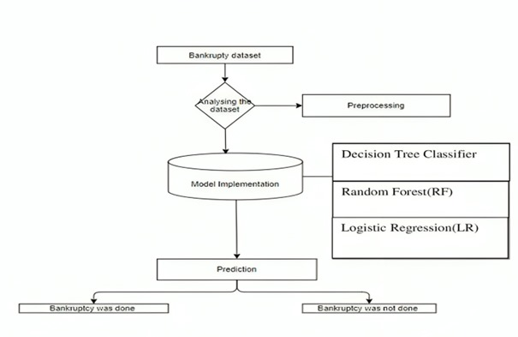
Block Diagram:

Slide 9
Features Extracting for Bankruptcy Prediction:
1. Financial Ratios:
Liquidity Ratios: Measures a firm's ability to meet short-term obligations (e.g., Current Ratio, Quick Ratio).
Solvency Ratios: Assesses long-term financial stability (e.g., Debt-to-Equity Ratio).
2. Profitability Metrics:
Net Profit Margin: Indicates overall profitability.
Return on Assets (ROA): Measures how efficiently a company utilizes its assets.
3. Cash Flow Analysis:
Operating Cash Flow: Tracks cash generation from core business activities.
Free Cash Flow: Highlights available cash after capital expenditures.

Slide 10
4. Market-Based Indicators:
Stock Price Volatility: Frequent fluctuations in stock prices can signal financial distress.
Market-to-Book Ratio: Compares a firm's market value to its book value.
5. Debt and Leverage Indicators:
Interest Coverage Ratio: Assesses a firm’s ability to pay interest expenses.
Total Liabilities to Total Assets Ratio: High values may indicate financial distress.
6. Operational Performance:
- Revenue Growth Rate: Declining revenue growth may predict financial instability.
- Inventory Turnover Ratio: Low turnover could suggest inefficiency or declining demand.

Slide 11
ATTRIBUTE INFORMATION
Id Company Identifier X1 net profit / total assets X2 total liabilities / total assets X3 working capital / total assets X4 current assets / short-term liabilities X5 [(cash + short-term securities + receivables - short-term liabilities) / (operating expenses - depreciation)] * 365 X6 retained earnings / total assets X7 EBIT / total assets X8 book value of equity / total liabilities X9 sales / total assets X10 equity / total assets
X11 (gross profit + extraordinary items + financial expenses) / total assets X12 gross profit / short-term liabilities X13 (gross profit + depreciation) / sales X14 (gross profit + interest) / total assets X15 (total liabilities * 365) / (gross profit + depreciation)

Slide 12
X16 (gross profit + depreciation) / total liabilities X17 total assets / total liabilities X18 gross profit / total assets X19 gross profit / sales X20 (inventory * 365) / sales
X21 sales (n) / sales (n-1) X22 profit on operating activities / total assets X23 net profit / sales X24 gross profit (in 3 years) / total assets
X25 (equity - share capital) / total assets X26 (net profit + depreciation) / total liabilities X27 profit on operating activities / financial expenses X28 working capital / fixed assets X29 logarithm of total assets X30 (total liabilities - cash) / sales
X31 (gross profit + interest) / sales X32 (current liabilities * 365) / cost of products sold X33 operating expenses / short-term liabilities X34 operating expenses / total liabilities

Slide 13
X35 profit on sales / total assets X36 total sales / total assets X37 (current assets - inventories) / long-term liabilities X38 constant capital / total assets X39 profit on sales / sales X40 (current assets - inventory - receivables) / short-term liabilities
X41 total liabilities / ((profit on operating activities + depreciation) * (12/365)) X42 profit on operating activities / sales X43 rotation receivables + inventory turnover in days X44 (receivables * 365) / sales X45 net profit / inventory X46 (current assets - inventory) / short-term liabilities X47 (inventory * 365) / cost of products sold X48 EBITDA (profit on operating activities - depreciation) / total assets X49 EBITDA (profit on operating activities - depreciation) / sales X50 current assets / total liabilities X51 short-term liabilities / total assets X52 (short-term liabilities * 365) / cost of products sold) X53 equity / fixed assets X54 constant capital / fixed assets

Slide 14
X55 working capital X56 (sales - cost of products sold) / sales X57 (current assets - inventory - short-term liabilities) / (sales - gross profit - depreciation) X58 total costs /total sales X59 long-term liabilities / equity X60 sales / inventory X61 sales / receivables X62 (short-term liabilities *365) / sales X63 sales / short-term liabilities X64 sales / fixed assets

Slide 15
Modules
1. Admin Module
This module is designed for administrative control over the entire system.
Admin Login: Allows system administrators to securely log in using credentials.
Manage Datasets: Enables uploading and preprocessing of financial datasets, including handling of missing values and normalization.
Train Dataset Model: Facilitates training of ML models using historical data to improve bankruptcy prediction accuracy.
Preprocessing & Algorithm Training: Offers a selection of algorithms (Decision Tree, Random Forest, Logistic Regression, and hybrid models) and tracks model training metrics like accuracy, precision, recall, and AUC.
View Results: Displays performance results of trained models to ensure effective risk prediction and evaluation.

Slide 16
2. User Module
This module handles interactions with users such as financial analysts or decision-makers.
Login and Registration:
User Registration: Allows users to create accounts with secure validation.
User Login: Verifies credentials for authenticated access to prediction tools.
Upload Dataset: Enables users to upload financial data for analysis.
Getting Results: Allows users to input data and instantly get predictions about whether a company is bankrupt or not.

Slide 17
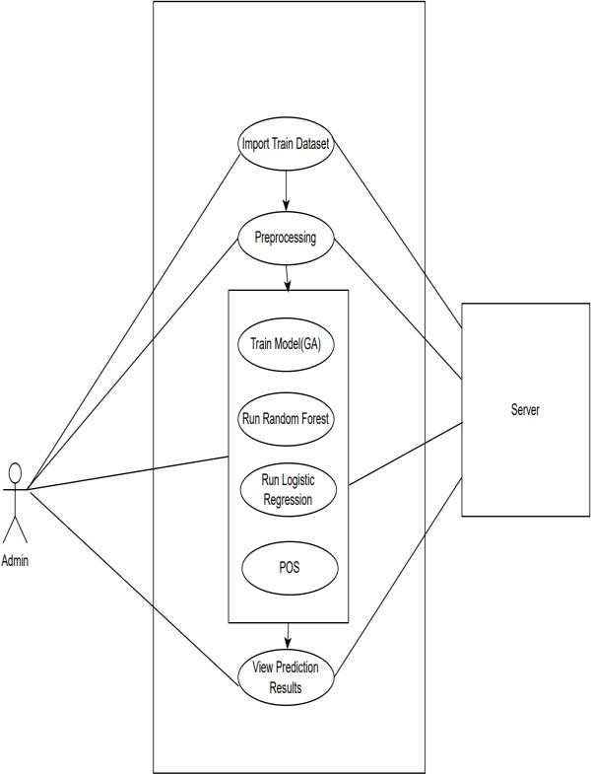
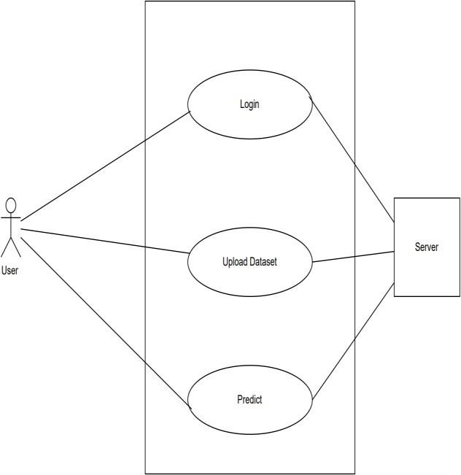
UML Diagrams:
Use Case Diagram For Admin Use Case Diagram For User

Slide 18
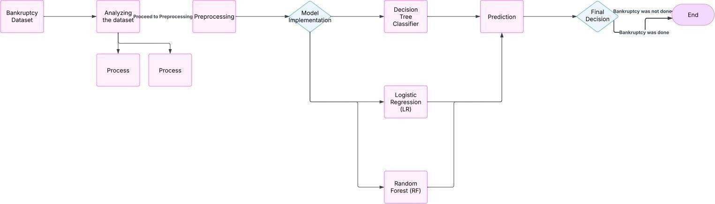
System Architecture:

Slide 19
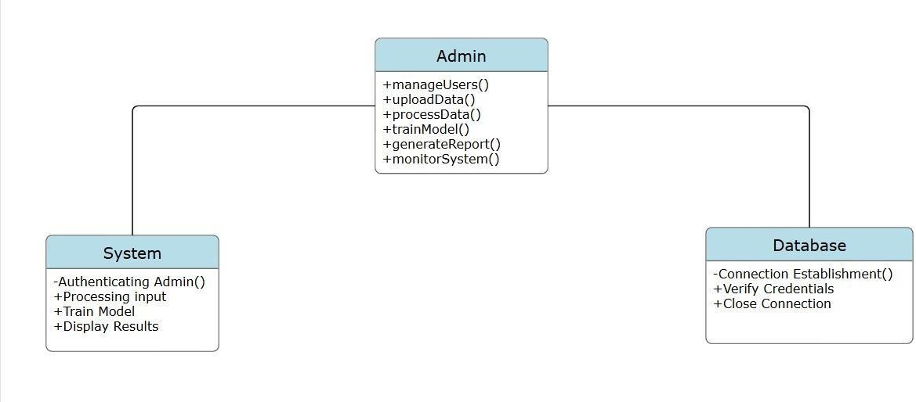
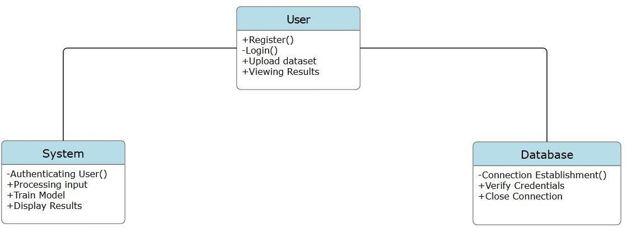
Class Diagram:
Admin Class Diagram
User Class Diagram

Slide 20
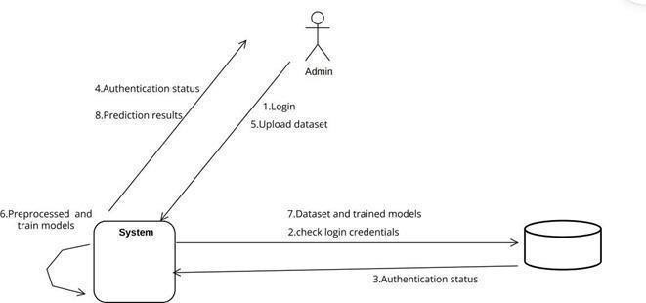
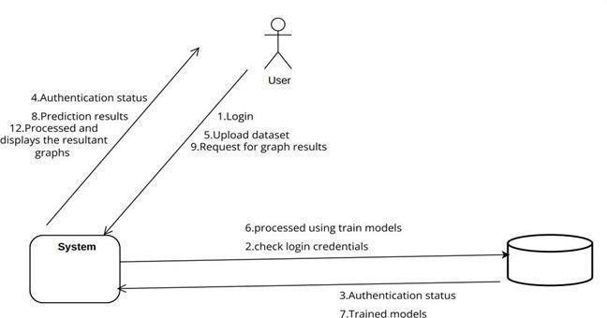
Object Collobration Diagram:
Admin Collaboration Diagram
User Collaboration Diagram

Slide 21
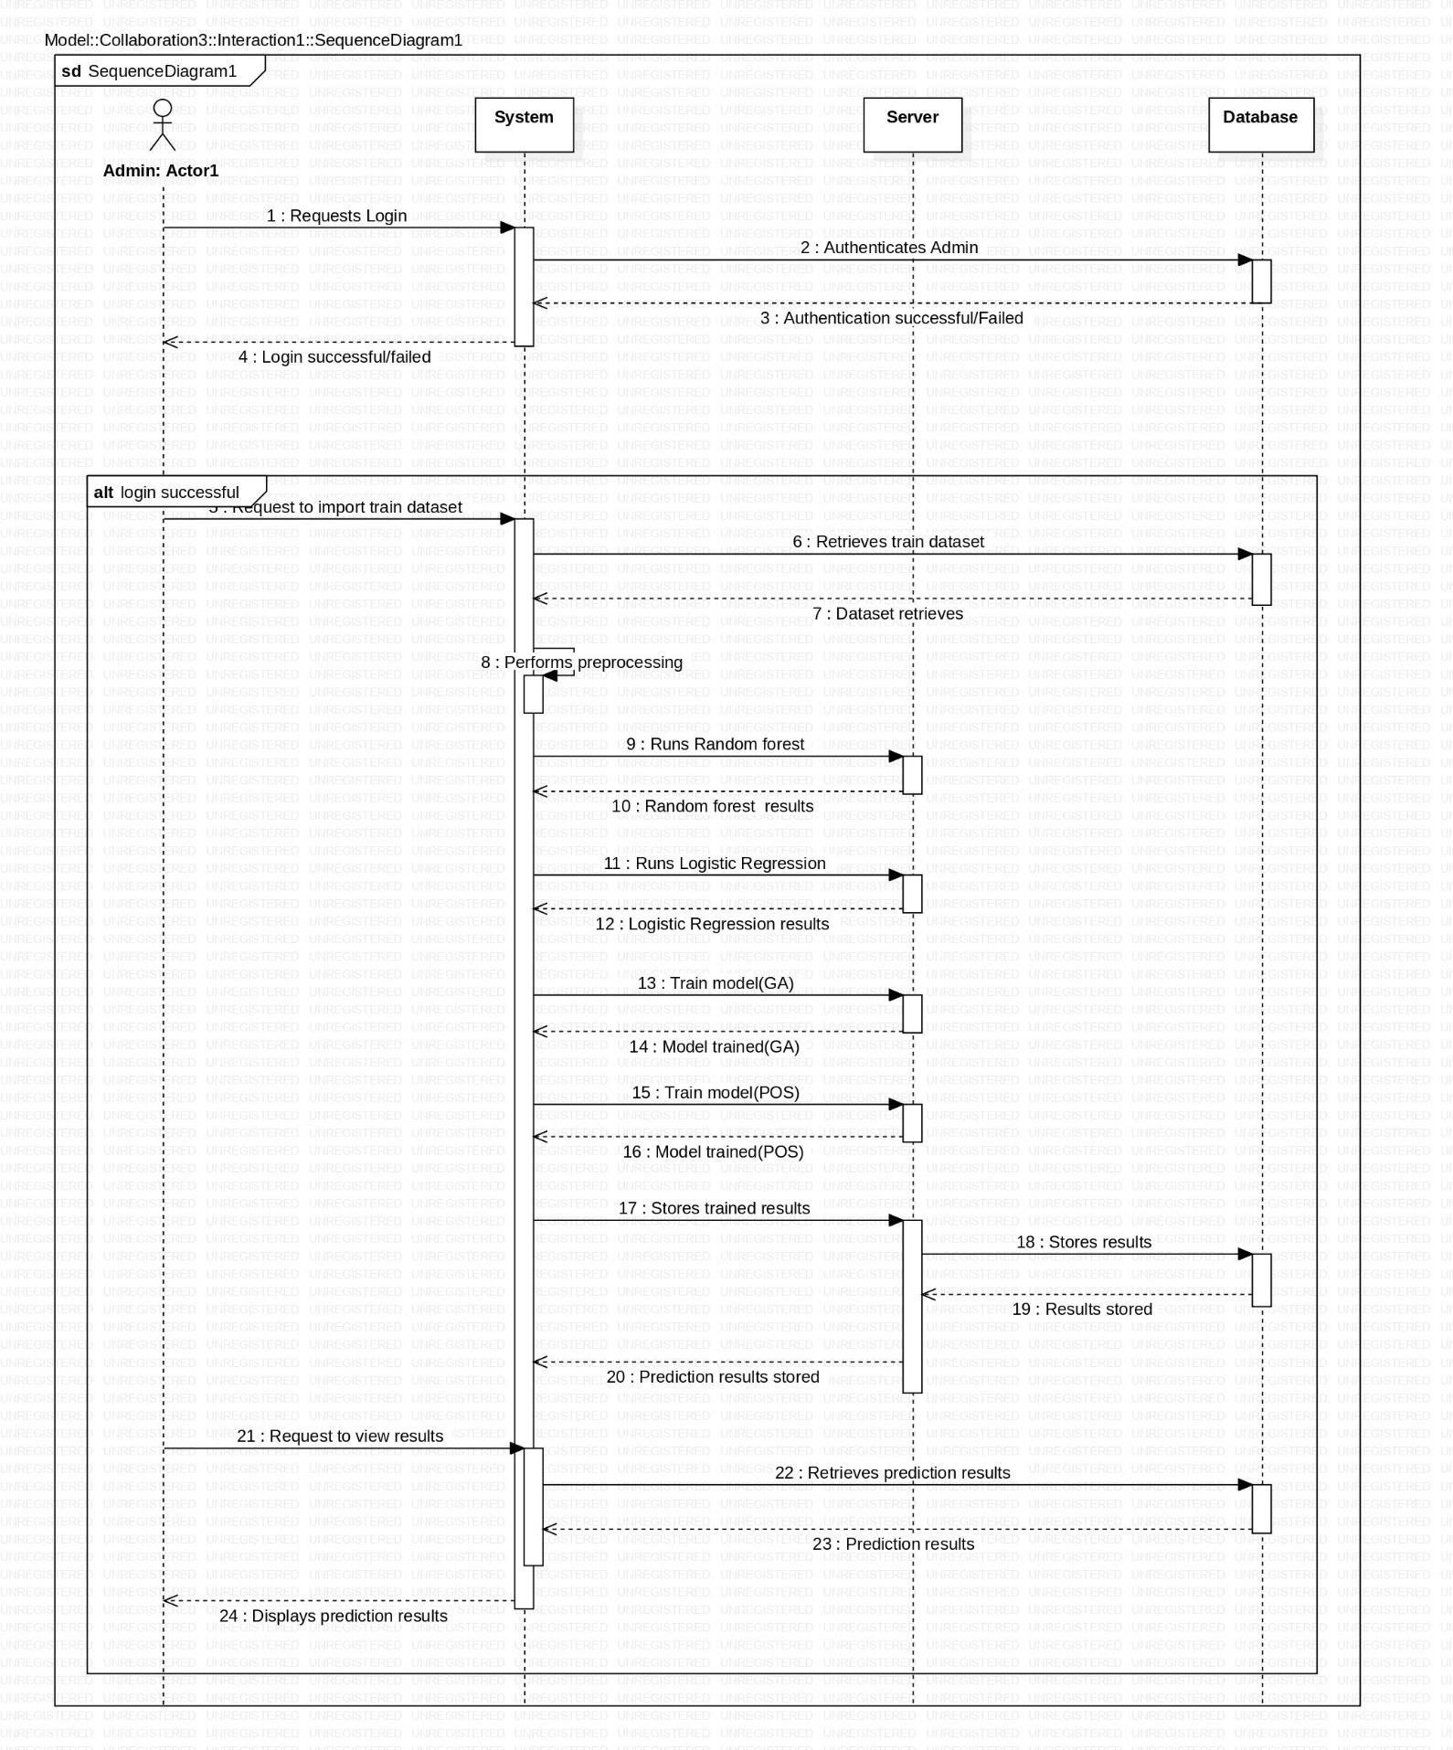
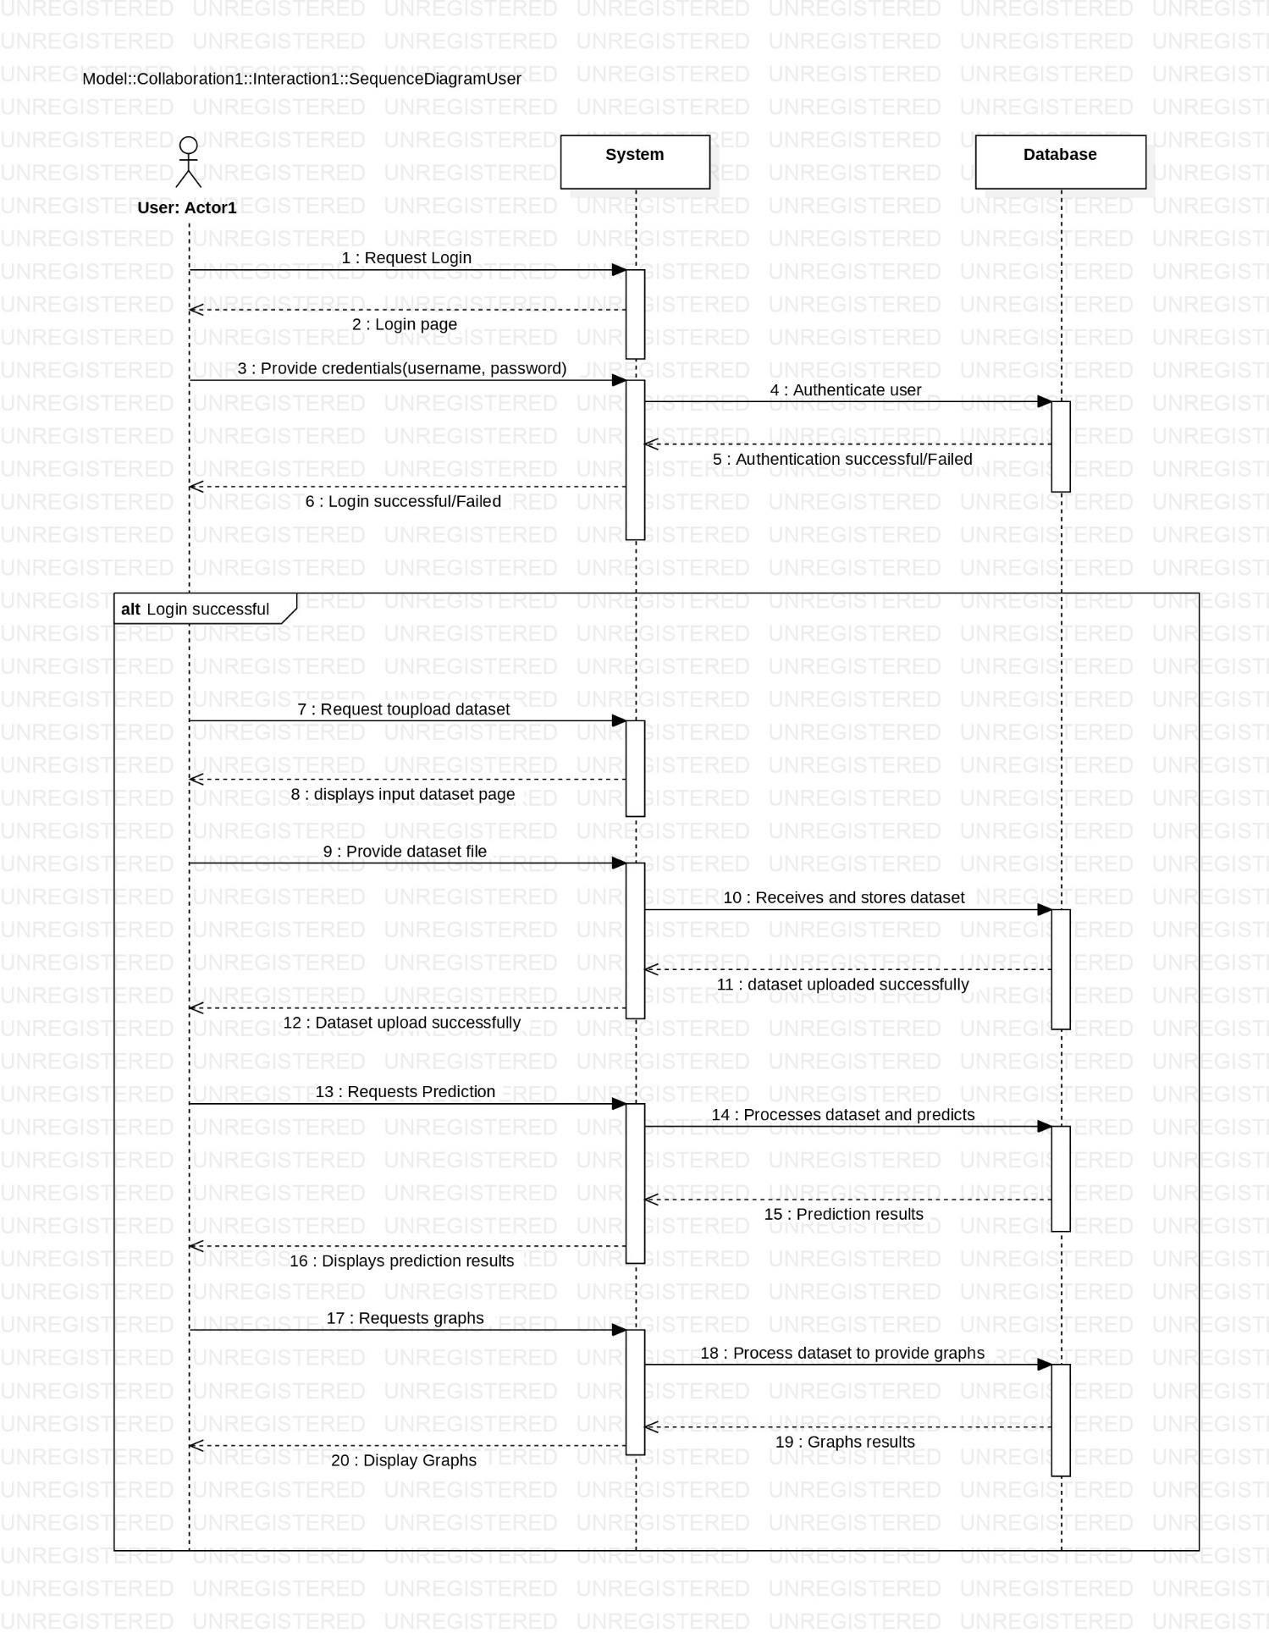
Sequence Diagram:
Admin Sequence Diagram
User Sequence Diagram

Slide 22
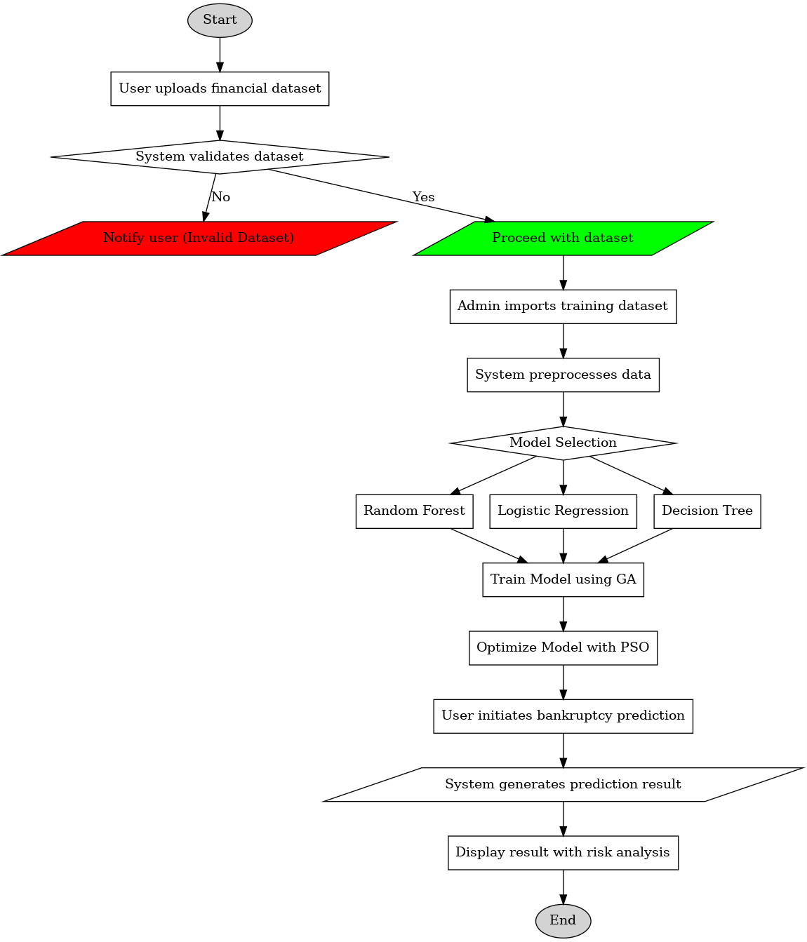
ACTIVITY DIAGRAM

Slide 23
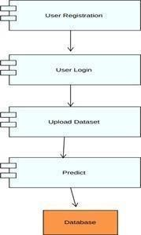
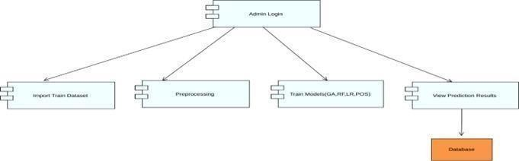
Component Diagram
Admin Component Diagram
User Component Diagram

Slide 24
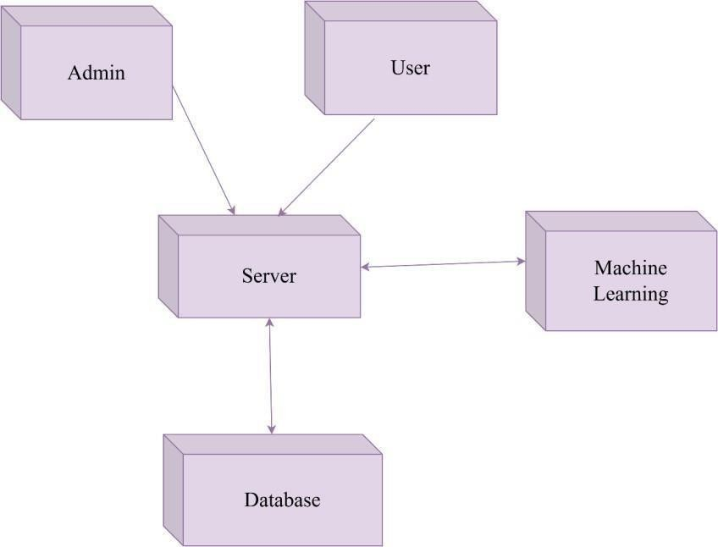
Deployment Diagram

Slide 25
IMPLEMENTATION
Dataset collection:
The dataset is taken from Kaggle Datasets which contains data of different companies along with the details.
Model development:
At first we take dataset which contains witch contain all the data year wise and take a year data for a set of countries and divide it into training and testing.
We build a NN model from scratch and train with train data then we save the model.
Testing:
After the model is build the testing data will be send through it for accuracy and the predictions will be made from that.

Slide 26
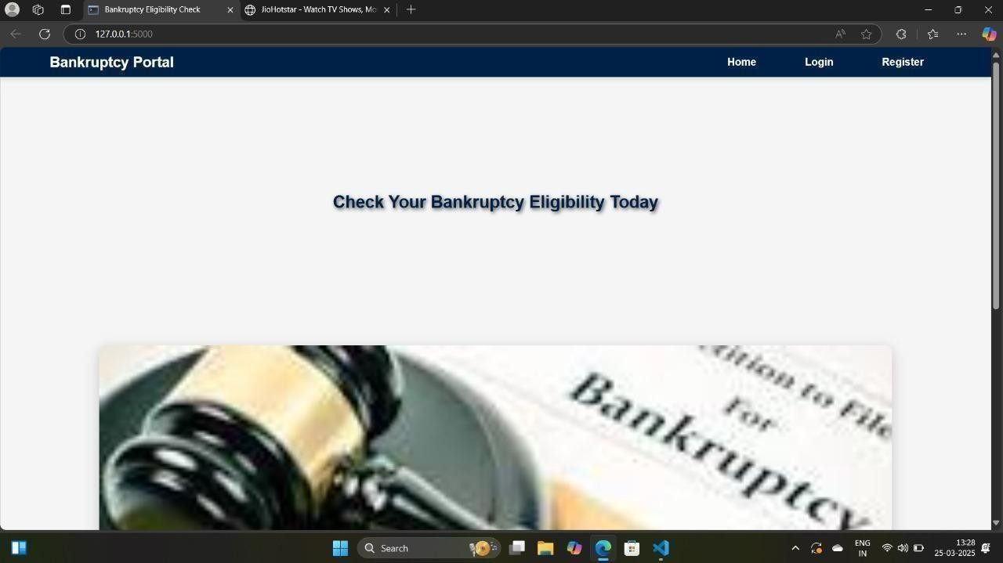
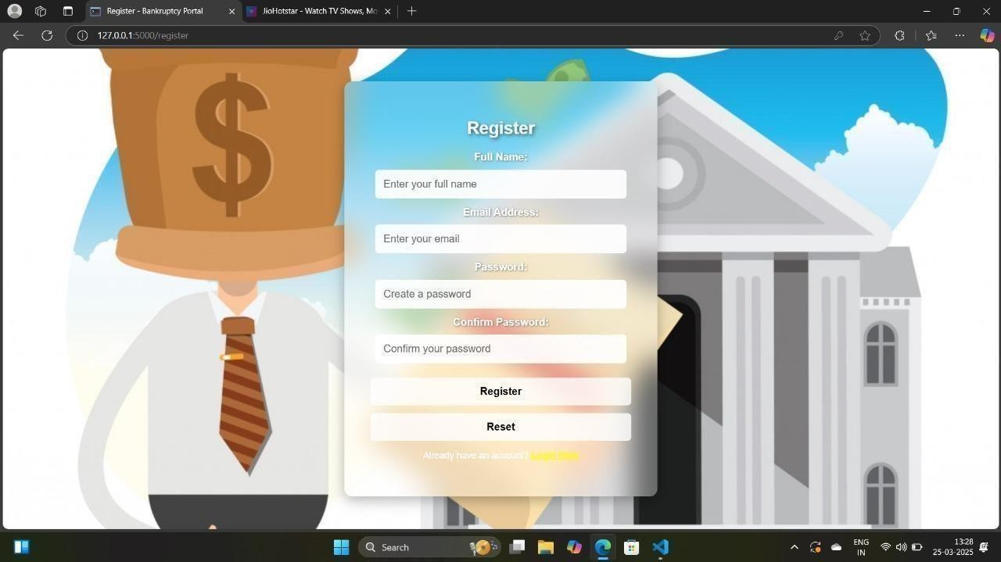
Outputs

Slide 27
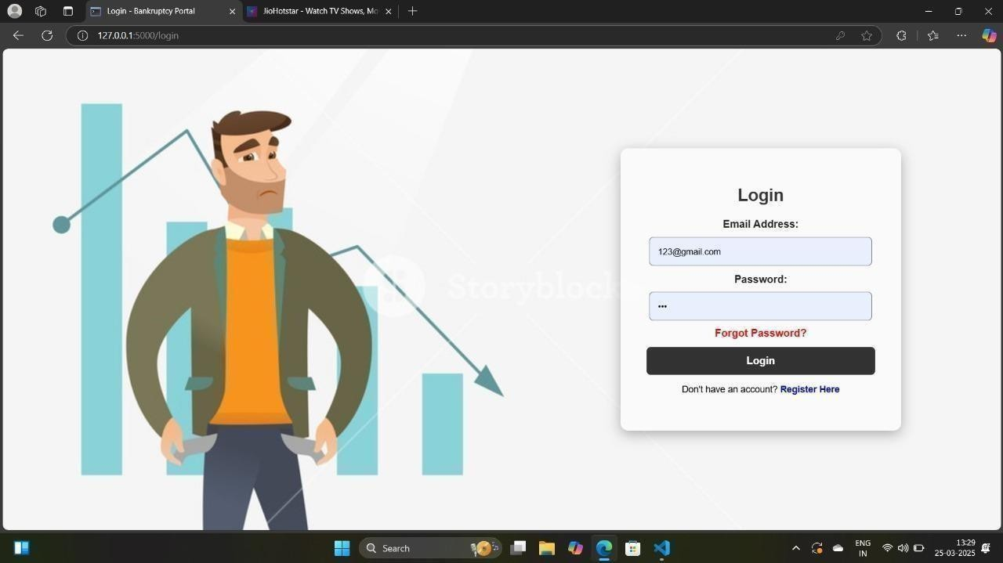
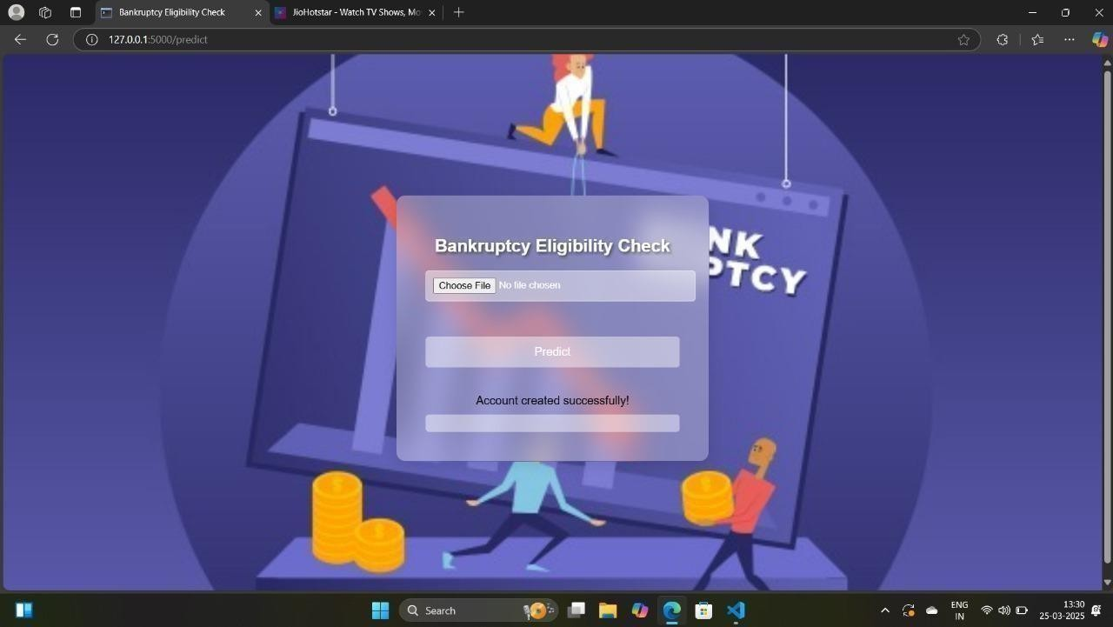

Slide 28
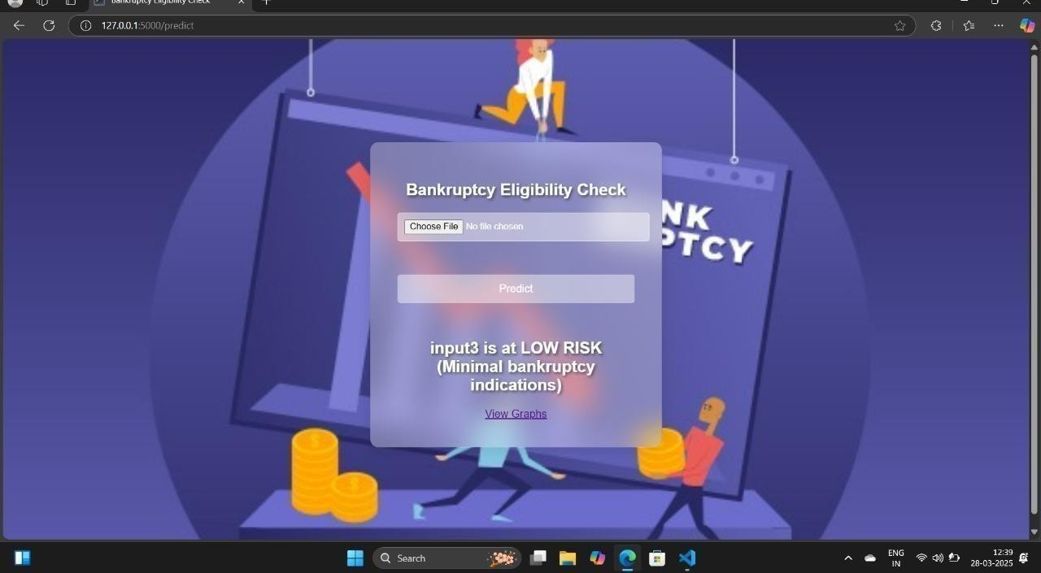
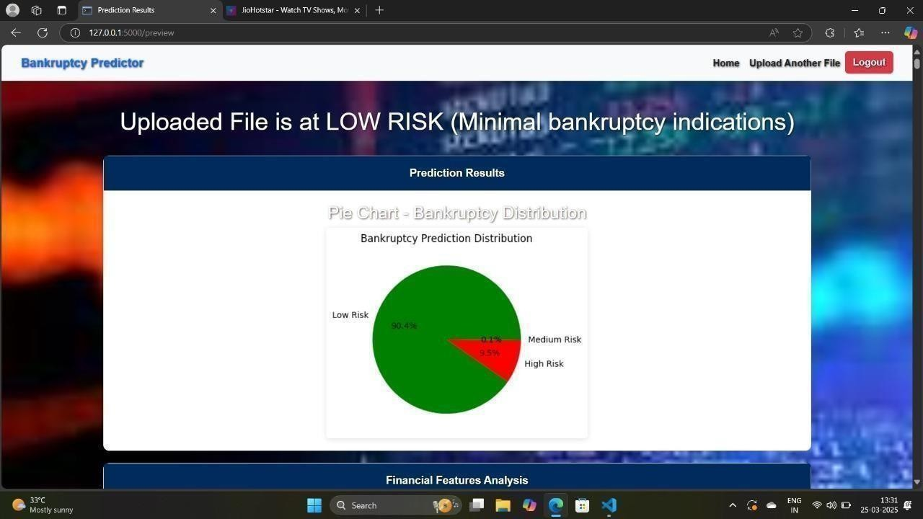

Slide 29
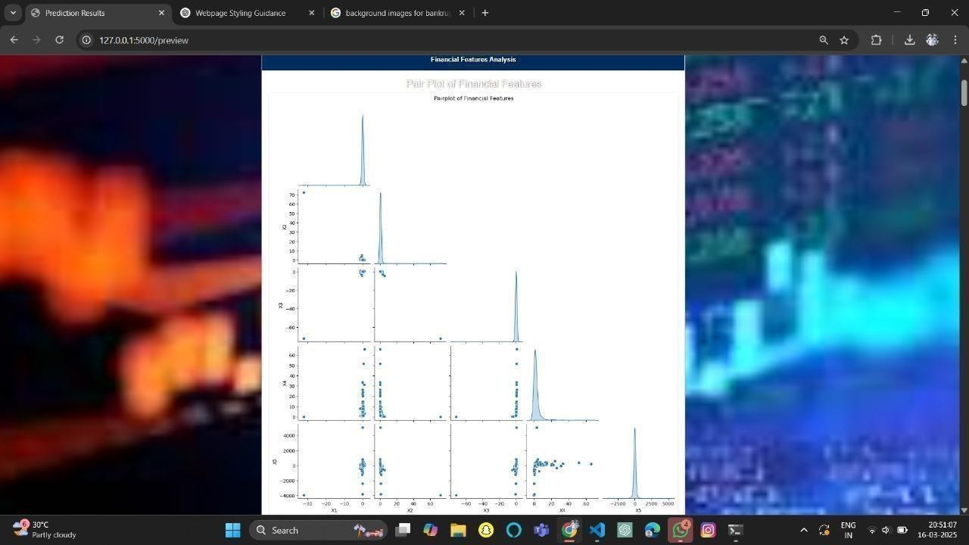
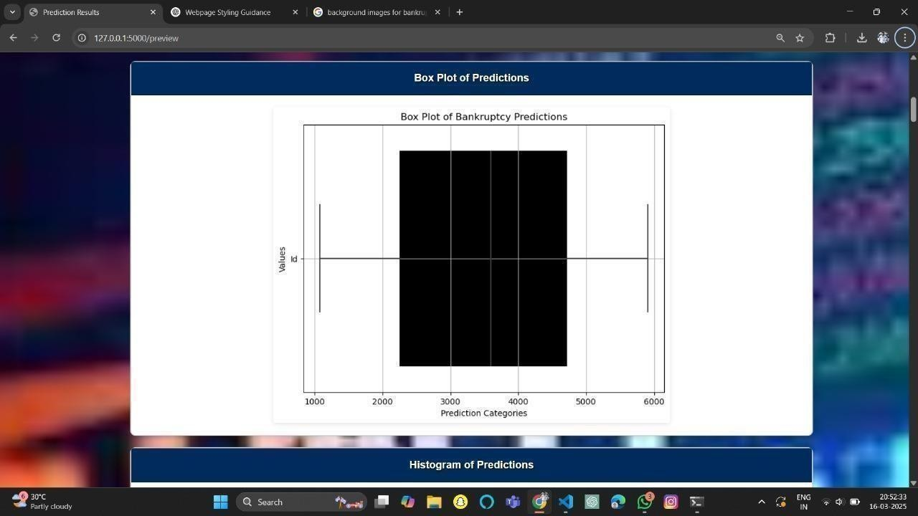

Slide 30
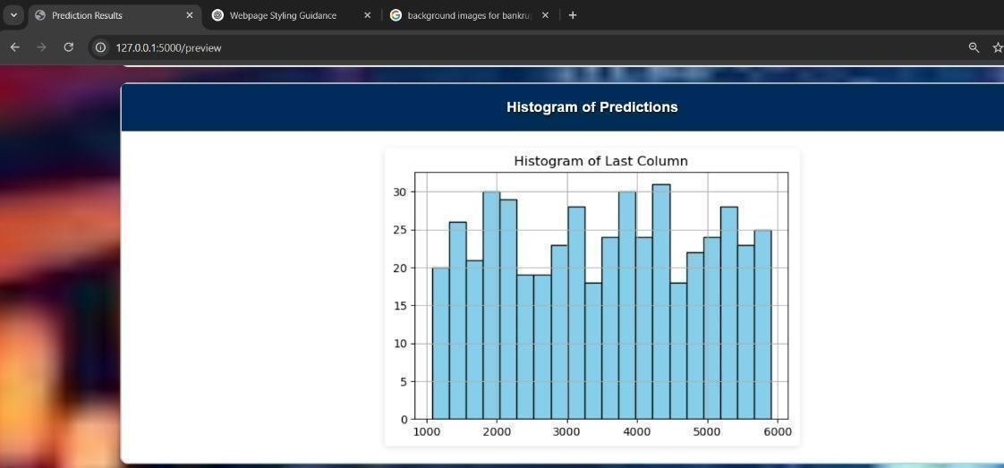

Slide 31
Conclusion
This project successfully develops a bankruptcy prediction system using machine learning techniques, specifically Random Forest (RF) and Logistic Regression (LR), to evaluate the financial stability of companies. By leveraging historical financial data, key financial ratios, and other relevant indicators, the system provides a data-driven approach to predicting the likelihood of bankruptcy. The project involves extensive data preprocessing, including handling missing values, feature selection, and normalization to ensure the models perform optimally. The Random Forest algorithm is particularly beneficial due to its ability to handle large datasets and reduce overfitting by aggregating multiple decision trees, leading to higher predictive accuracy. Logistic Regression, on the other hand, provides a more interpretable model by estimating the probability of bankruptcy based on selected financial features. The system is designed to assist businesses, investors, and financial analysts in identifying financial distress early, allowing for timely intervention and strategic decision-making. One of the significant advantages of this approach is its flexibility, as the model can be trained on different datasets from various industries, making it widely applicable. Additionally, the project highlights the importance of selecting relevant financial indicators that directly impact a company’s financial health. Future improvements may include integrating additional machine learning models such as Gradient Boosting or PS for enhanced predictive performance. Incorporating macroeconomic indicators, industry-specific trends, and sentiment analysis from financial news could further refine predictions.

Slide 32


